Slide 1

By: Manas Tuwani

Slide 2

Return Type in Java
Every method in Java is declared with a return type and it is mandatory for all java methods. A return type may be a primitive type like int, float, double, or void type(returns nothing).
Note: The type of data returned by a method must be compatible with the return type specified by the method.

Slide 3

Return can be used with methods in two ways:
Methods returning a value: For method that define the return type, return statement must be immediately followed by return value.
Methods not returning a value: For methods that don’t return a value, return statements can be skipped.

Slide 4
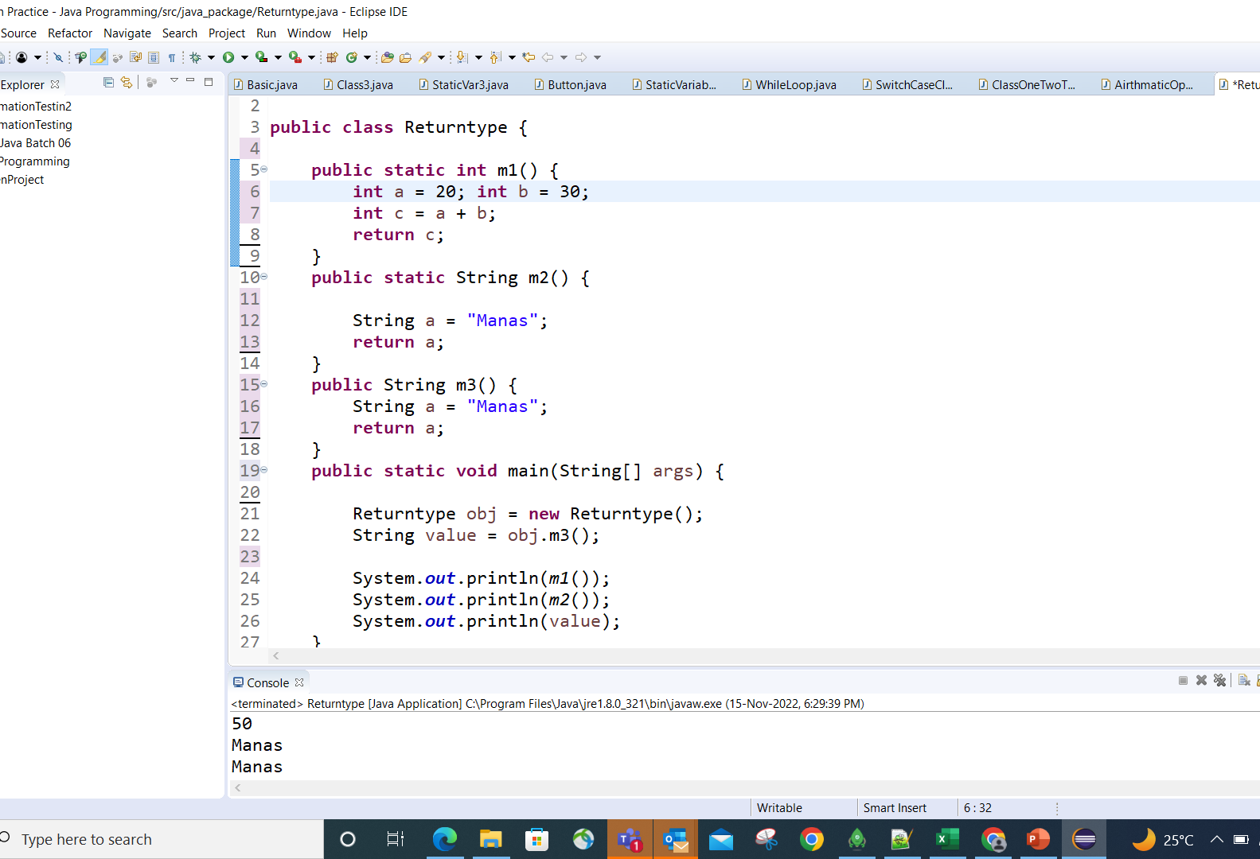

Slide 5
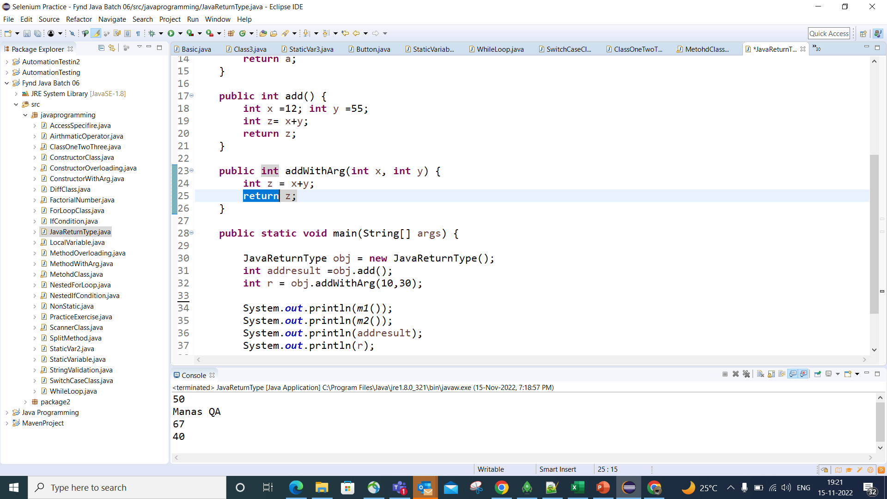

Slide 6
